Slide 1


CHAPTER - 1
Introduction to Computing
Presented by Henil Patel

Slide 2

1.1 : Introduction
Computing is an operation that involves processing of the data by making use of a computer. In this chapter, we will briefly discuss the different hardware components of a computer. We will also discuss methods to develope programs using which we can achive our objective to solve problems and perform various computational activities.

Slide 3
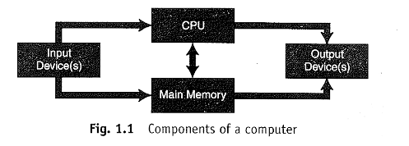
1.2 : Components of a Computer
  A computer is an electronic device which may be used to perform various computations involving arithmatic and logical operations.
  It consists of three main parts : CPU , I/O , MEMORY

Slide 4
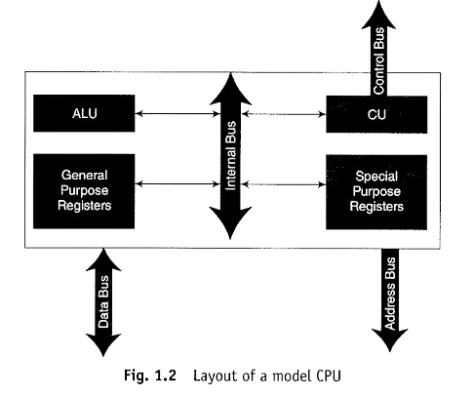
1.2.1 : Central Processing Unit
  CPU is a unit in which all processing activities take place . The CPU is an example of very large scale integrated electronic circuit (VLSI) .
  CPU consists of ALU ( Arithmatic and Logical Unit) , CU (Control Unit) .
  ALU : The ALU contains circuits using which various arithmetic and logical operations may be executed. These circuits include adders (for addition), subtractors (for subtraction), comparators (for comparison of operands), etc.
  CU : The CU, also known as the brain of a computer, is the unit which is responsible for generating control signals. These control signals control the working of the various components within a computer.

Slide 5
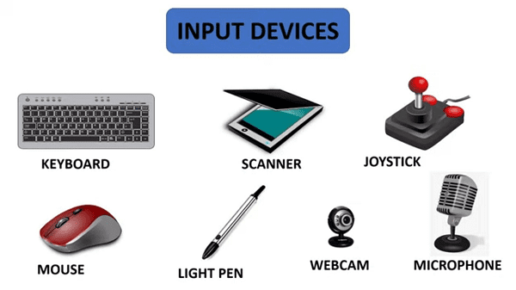
1.2.2 : Input Devices
  Input devices are the one through which user are allowed to input data and other instruction to the computer .
  The most popular choices for the input devices are the keyboard and the mouse .
  EX : Scanner , readers , microphone , etc. . .

Slide 6
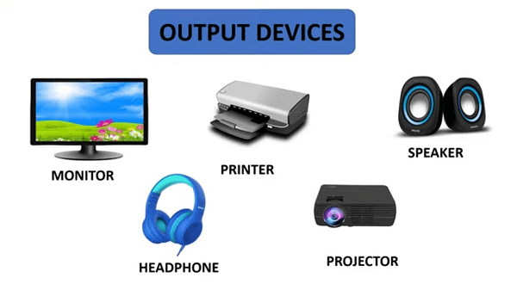
1.2.3 : Output Devices
  As input device is used to convey message to the computer , output device is used by the computer to convey messages back to the users .
  The most common example of output device is monitor .
  EX : printer , speakers , plotters etc. . .

Slide 7
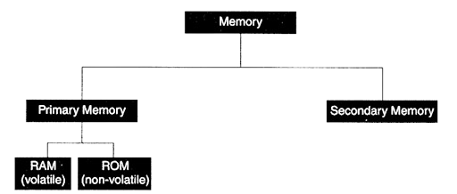
1.2.4 : Memory
The computer’s memory may be classified into different types . The below figure shows the classification of the computer’s memory .

Slide 8
Primary Memory
Secondary Memory
  The primary memory, also known as the main memory, is so because the CPU can directly interact with it .
  The random memory is of two main type :
  RAM(Random access memory) : The RAM is a volatile memory that stores instructions and data related to the program currently being executed. The RAM is volatile because it would lose all the information stored in it as soon as the power to the computer is switched off. It allows read and write operations.
  ROM(Read only memory) : The ROM is a read-only, non-volatile memory. The ROM does not permit any write operation and is non-volatile because the information stored in it would be retained even after the computer has been switched off.
  The secondary memory, also known as auxiliary memory, is a large depository of non-volatile storage space that can store information for as long as we want.
  In this respect it is worth mentioning that the secondary memory is slower compared to the access time of the primary memory.
  The hard disk, flash drives, etc. are some examples of secondary memory.

Slide 9
1.3 : Concept of Hardware and Software
  The hardware of a computer consists of various electronic, electro-mechanical and electro-magnetic devices along with the interfacing connecting them.
  Software, on the other hand, consists of the set of instructions, commands, programs, etc. that can make the machinery operate and fulfill our objectives. If the hardware is the body, then the software is the soul of a system.
1.3.1 : Types of Software
  Depending upon the type of work a software is required to perform .
  It can be classified into two categories : System Software and Application Software

Slide 10
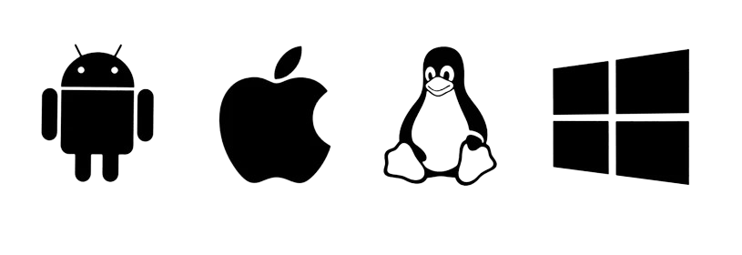
1.3.2 : System Software
  System softwares are the ones that closely interact with the hardware of a computer.
  They are responsible for controlling the resources of the system and perform other activities related to the system.
  The different kinds of system softwares are operating system, loader, linker and translators.
  Operating System
Operating system is a system software which acts as an interface between the user and the hardware. The operating systems currently in use are Linux, Windows 10, UNIX, macOS, etc.

Slide 11
  Translators
Translators cover a class of system softwares which translate a program written in one programming language into another. Compiler, assembler, interpreter, etc, are few of the most used translators.
  Compilers
Compilers are system softwares that translate a program written in high level language (HLL) into machine language. C, C++, Java, etc. are examples of HLLs. Thus, compilers have to be aware of the HLL and the instruction set, addressing modes, register configuration, etc. of the machine in which the target program is supposed to be executed.
  Assemblers
Assemblers translate a program written in assembly language to machine language. Assembly language consists of instructions supported by the underlying processor.

Slide 12
  Linker
The linker links together the object codes belonging to all the sub-routines/functions of a program and forms an executable code. This executable code may be stored in the secondary memory and can be loaded into me main memory as and when required for execution.
  Loader
The loader is a system software that loads a program to be executed from the secondary memory into a designated area of the main memory. Modern day operating systems have a loader incorporated within them. Absolute loaders, relocatable loaders, direct linking loaders are few forms of loader.

Slide 13
1.3.2 : Application Software
  Application software are the ones that are meant to perform a specific activity and aid users in various ways.
  Word processing software, image editing, spread sheet packages, database software and accounting software are all examples of application software.
  Each of these has been designed to serve a special purpose.
  This are the types of software which runs on system software.
  Without system software application software can’t work.

Slide 14
1.4 : Programming Language and their Generations
  Software can be considered as a set of programs which work in a cohesive manner to perform a task.
  A program is a set of instructions written in a programming language, which when executed in sequence performs a task.
1.4.1 : Programming Languages
A programming language gives a system of syntax and semantics using which a program can be written. Syntax is to a programming language in the same as grammar is to any spoken language. It lays down the rules that define the structure of the symbols, punctuation, tokens and keywords of a programming language.

Slide 15
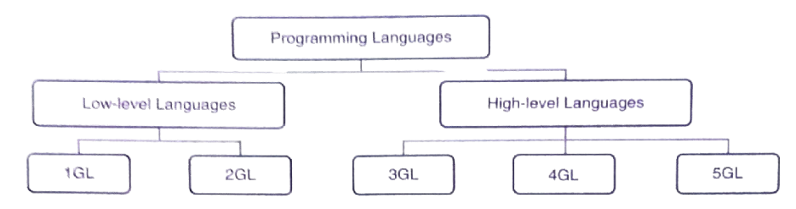
1.4.2 : Generations of Programming Languages
The evolution can be broadly categorised into five stages, popularly known as the Generations of Programming Languages, where each generation has offered better features, greater efficiency, superior technology and more user-friendliness than the previous one.

Slide 16
1.4.2.1 : Low - Level Languages(LLL)
  The earliest languages developed were low-level languages. They are close to hardware and can give machine-level instructions.
  The first- and second-generation languages are low-level languages,
  First Generation Languages (1GL)
The first generation language are also known as Machine Language, is written entirely in binary code (‘0’ and ‘1’) It is the only programming language that a digital machine can directly execute without requiring any translation.
  Second Generation Languages (2GL)
The second-generation includes Assembly Language that uses mnemonic operation codes and symbolic addresses for writing a program.

Slide 17
1.4.2.2 : High - Level Languages(HLL)
  High-level languages are closed to human understandable languages and the program written in HLL are usually independent of the hardware of the system.
  Third and the higher generation languages are all high-level languages.
  Third-Generation Languages (3GL)
Using third-generation languages, programs are usually weitten as a series of english like words that are more human understable.In order to execute 3GL, it need to be either compiled or interpreted or sometimes both. EX : c, c++, java, etc. . .
  Forth-Generation Languages (4GL)
In 4GL we need to only state what to do without giving details How to do. The other languages with 4GL capability are PHP, Python, etc. . .
  Fifth-Generation Languages (5GL)
Fifth-generation languages implement the concepts of artificial intelligence and neural networks.

Slide 18
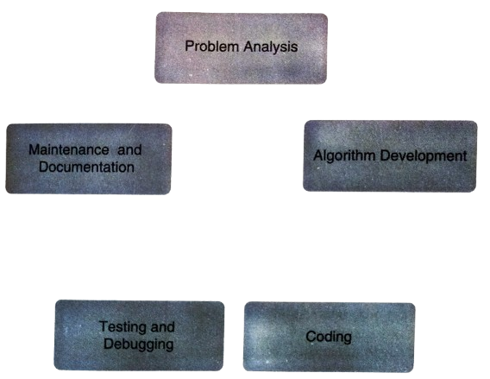
1.5 : Program Development Life Cycle of a C Program
Developing a program or a project in c is not a single task, but requires a specific sequence of steps, called the phases of program development.

Slide 19
1.5.1 : Problem Analysis
When the problem is recived, the programmer try to understand the problem at first. The y determine weather the problem is valid or not and can have a solution or not.
1.5.2 : Algorithm Development
In order to attain the selected solution, a step-by-step procedure is developed. The modules in the program are identified, and algorithm for each module or function is written. The variables, files, functions, etc., are determined. The logical flow of control is determined in this phase.
1.5.2 : Coding
The algorithms developed in the previous phase are converted to C language code. Programmer should follow the syntax of C language while writing the code, a deviation from which leads to errors.

Slide 20
1.5.4 : Testing and Debugging
  Once the initial code is written and syntax errors are corrected, the program is executed to see the outputs The outputs may be correct or incorrect.
  Incorrect outputs may result from incorrect logic or overlooking program constraints.
  By examining the outputs from the test cases, the errors or bugs are identified. The bugs are removed through the debugging process.
1.5.4 : Maintenance and Documentation
  Any changes made to the program after its installation is called maintenance. Periodic maintenance is done to cater to the changing requirements in the place of deployment, or to debug previously unidentified bugs.
  A very important activity that needs to be done throughout each phase of program development is documentation. At the end of program development, it is desirable to consolidate all algorithms, flowcharts, etc. . . in a manual that states the program's functionality.

Slide 21
1.6 : Algorithms and Flowcharts
  Algorithms and flowcharts these are two primary tools that are used to develop programming logic before we start coding in C.
  Logic development is a vital requirement of a programmer, and so it needs to be learnt.
  It is advisable to always use tools such as algorithms and flowcharts to first plan and then write a program.
  After all it has been rightly said that well planned is half done.

Slide 22
1.6.1 : Algorithm
  An algorithm is a finite set of unambiguous instructions which, when executed, performs a task correctly. There are three characteristic features in this description of an algorithm. They are:
  The number of steps required to perform the task should be finite.
  Each of the instruction in the algorithm should be unambiguous in nature; meaning on the execution of each such instruction, the outcome should be definite and predictable.
  Finally, the algorithm should solve the problem correctly. In other words, on the execution of the algorithm, the objective should be fulfilled.
  There are no defined rules to write an algorithm.

Slide 23
Example
Problem - Develop an algorithm to find the average of three number taken input from the user.
Algorithm Average
Step 0 : Start
Step 1 : Input number in variable A
Step 2 : Input number in variable B
Step 3 : Input number in variable C
Step 4 : Sum = A + B + C
Step 5 : Avg = Sum / 3
Step 6 : Print Avg
Step 7 : End

Slide 24
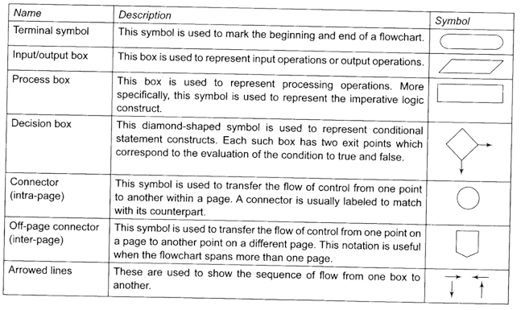
1.6.2 : Flowchart
  Just like the algorithm, the flowchart is also a tool to represent logic.
  As the name indicates, a flowchart helps us graphically visualize the flow of control within the sequence of statements.
  At times it becomes easier for us to understand logic better when we have a picture in front of us.

Slide 25
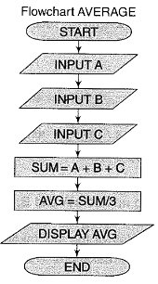
Example
Problem - Develop an algorithm to find the average of three number taken input from the user.
Algorithm Average
Step 0 : Start
Step 1 : Input number in variable A
Step 2 : Input number in variable B
Step 3 : Input number in variable C
Step 4 : Sum = A + B + C
Step 5 : Avg = Sum / 3
Step 6 : Print Avg
Step 7 : End

Slide 26
Reference
Link Name: Microsoft Power Point
﻿Brief Description: Used for making PPT
Link Name: E Balagurusamy
﻿Brief Description: Content of the PPT

Slide 27

Thank You
For your attention

